Slide 1
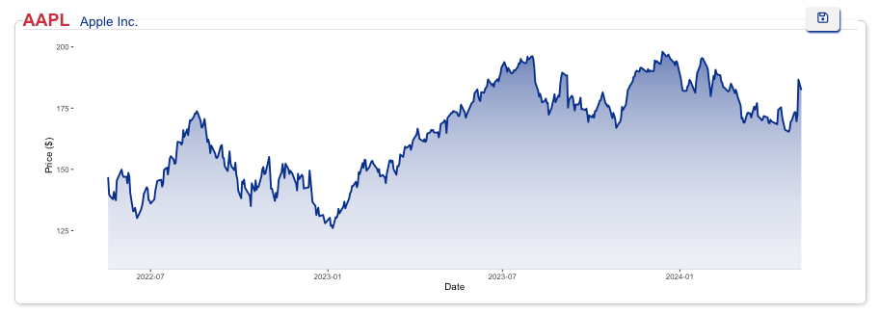

The Impact of R/R Shiny in Finance
Loan K Robinson Nov 16th, 2024
https://loanrobinsonscientist.shinyapps.io/stock_dashboard_app_final
https://loanrobinsonscientist.shinyapps.io/stock_dashboard_dataconla2024
https://github.com/loankimrobinson/stock_dashboard_dataconla2024

Slide 2
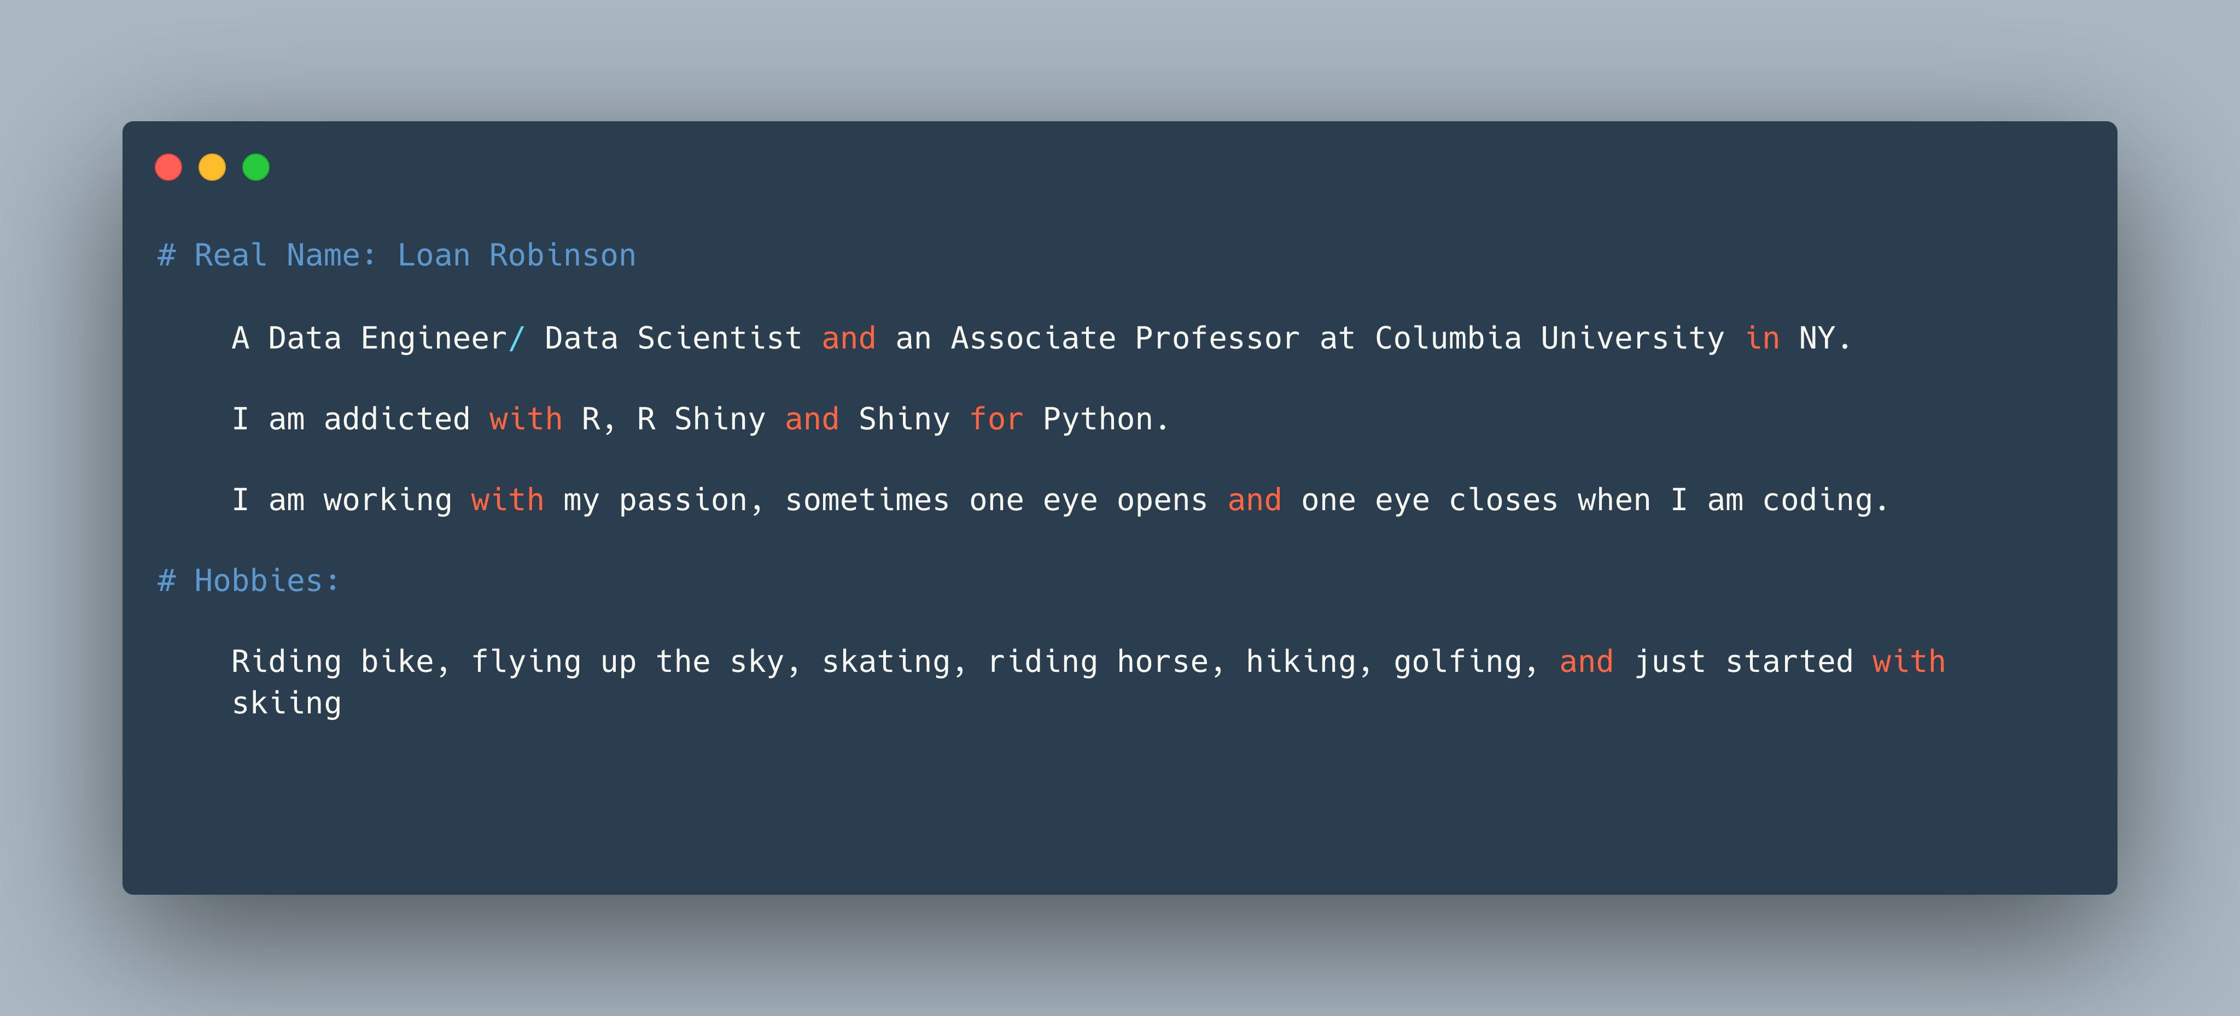
Who I am?

Slide 3

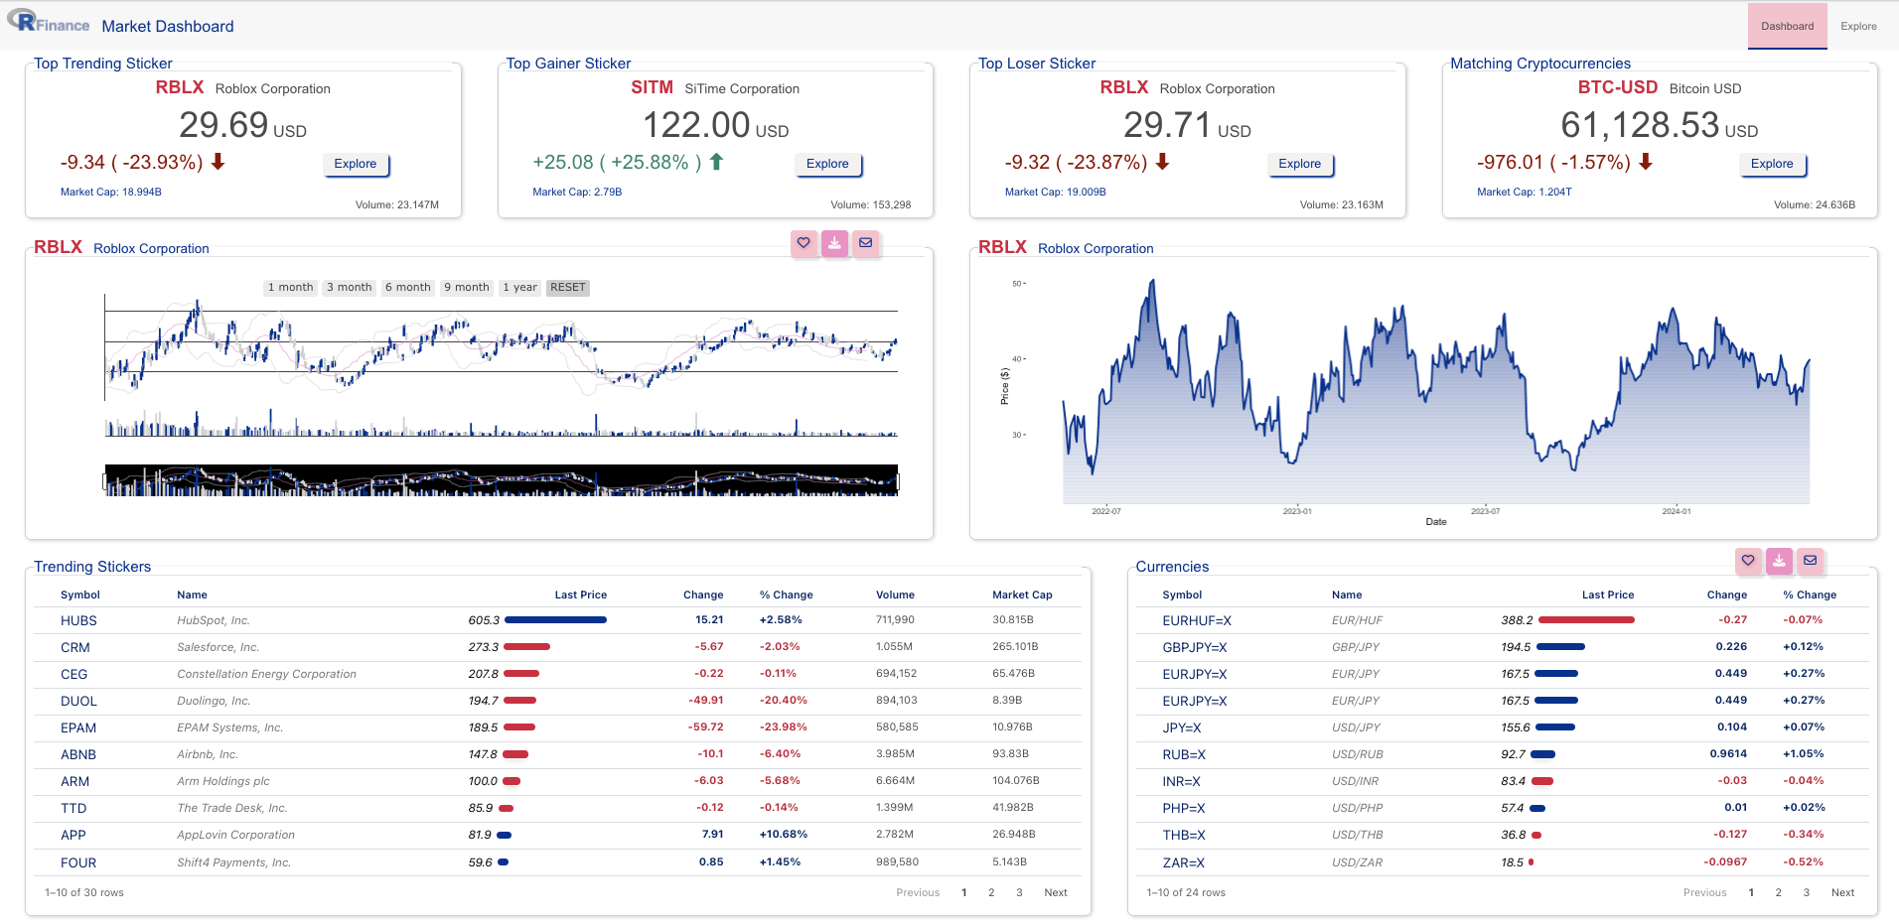


RShiny App Structure
Server (Backend)
Client (User Interface)
Local Machine
Cloud (shinyapps.io)
https://loanrobinsonscientist.shinyapps.io/stock_dashboard_app_final/
https://loanrobinsonscientist.shinyapps.io/stock_dashboard_dataconla2024

Slide 4
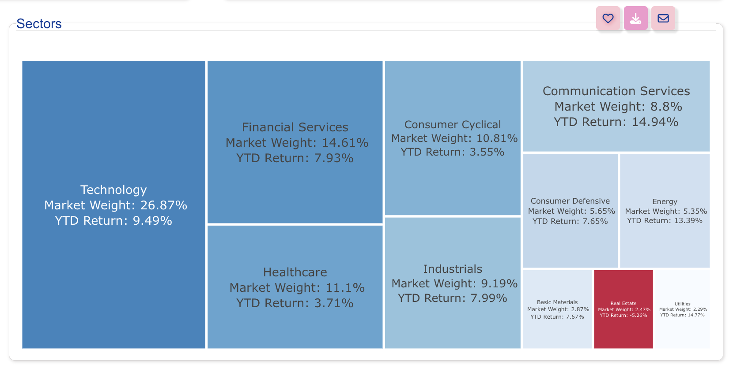
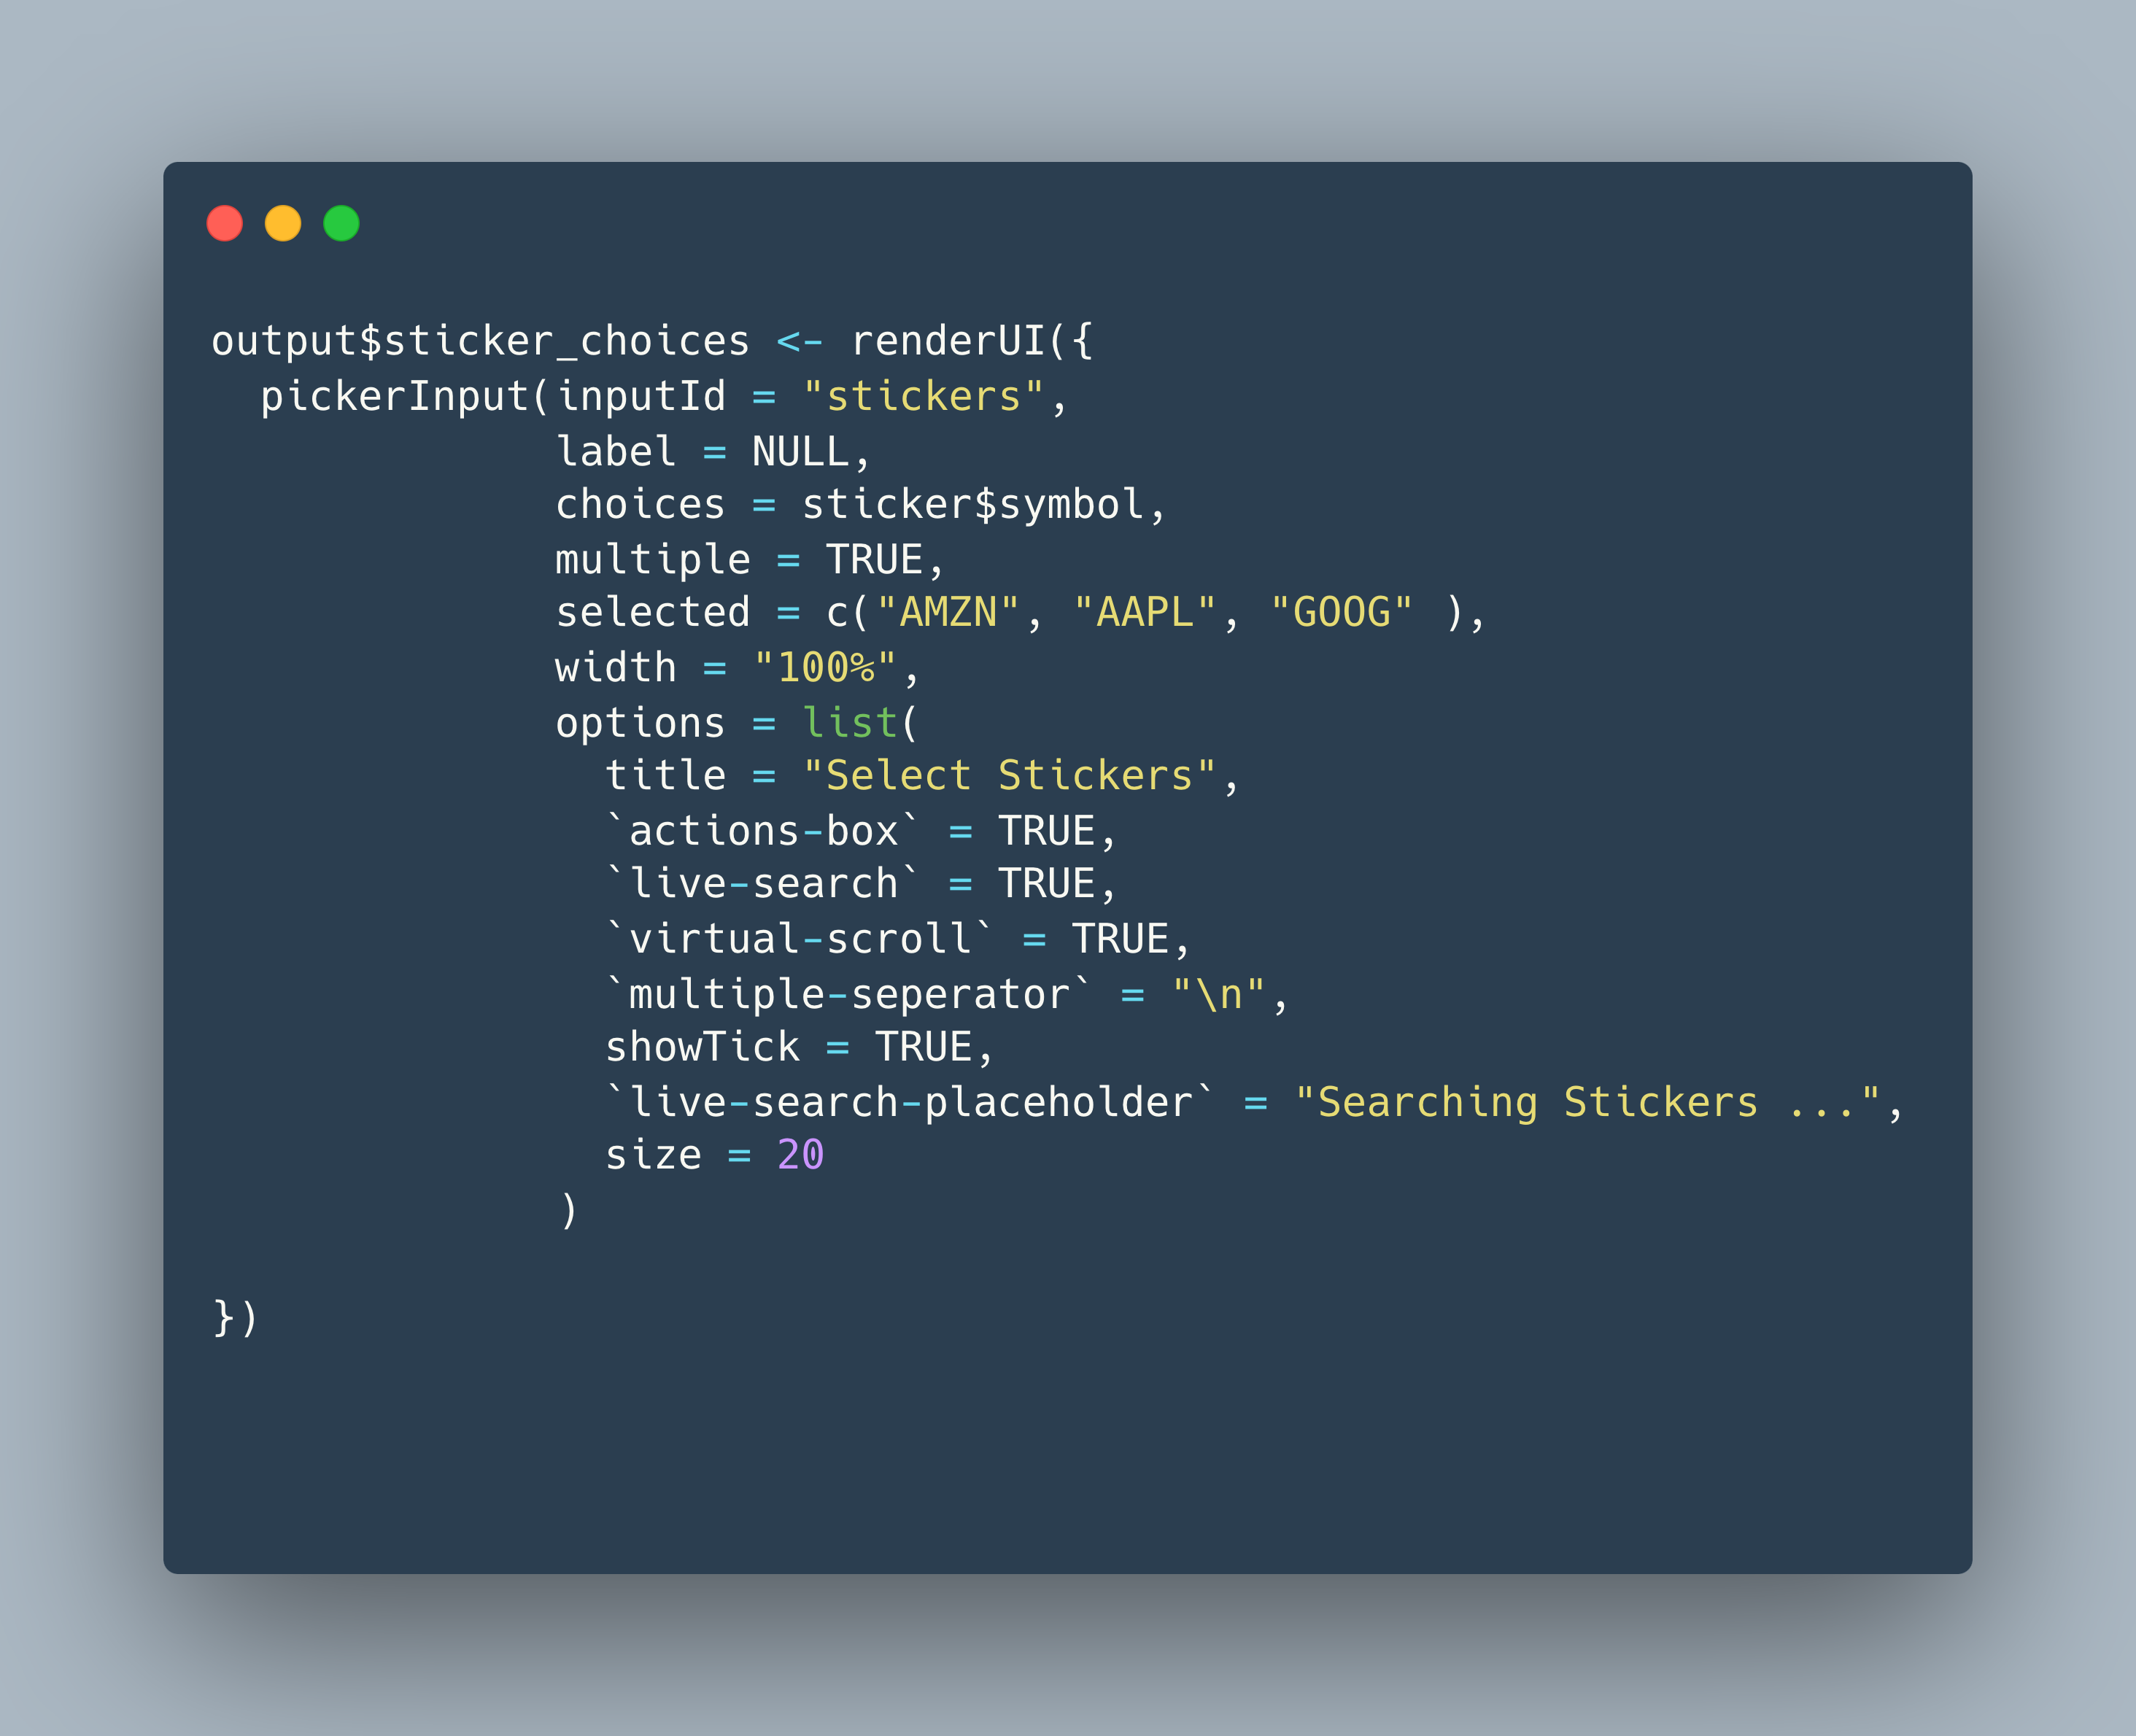
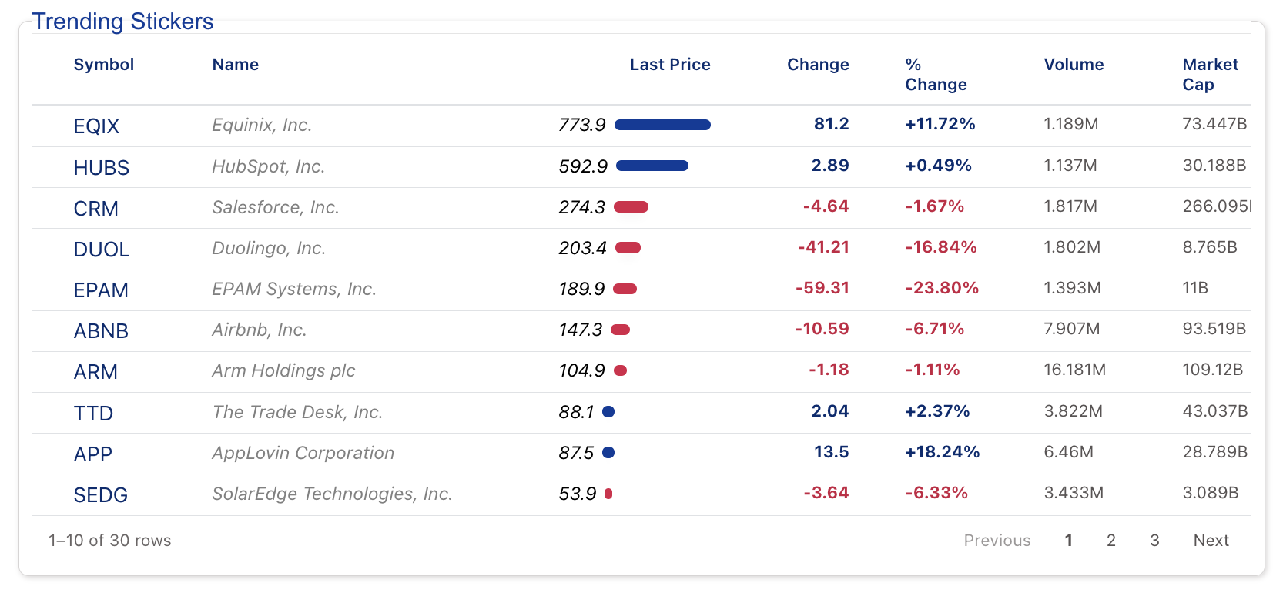
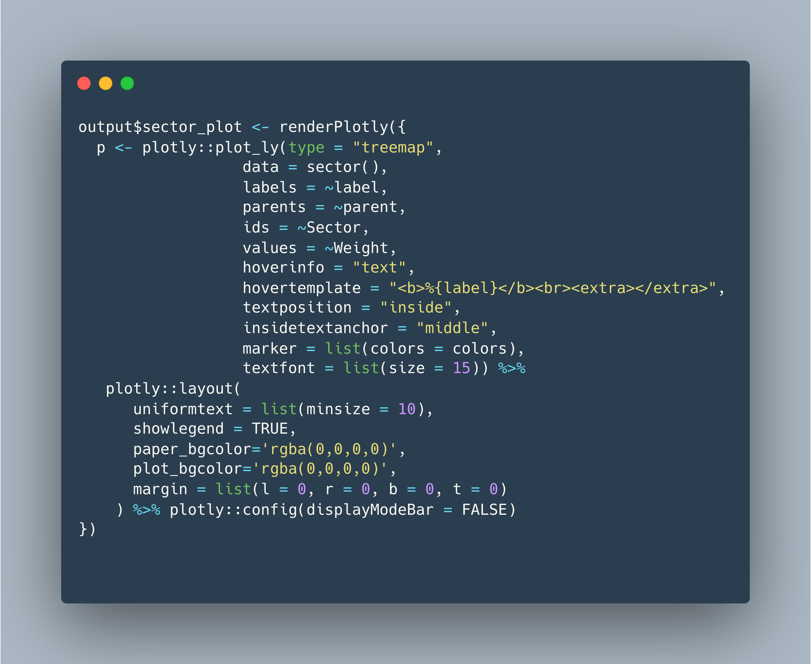
R Shiny App
ui
pickerInput()
dateInput()
Outputs
Inputs
server
renderPlotly()
renderReactable()

Slide 5
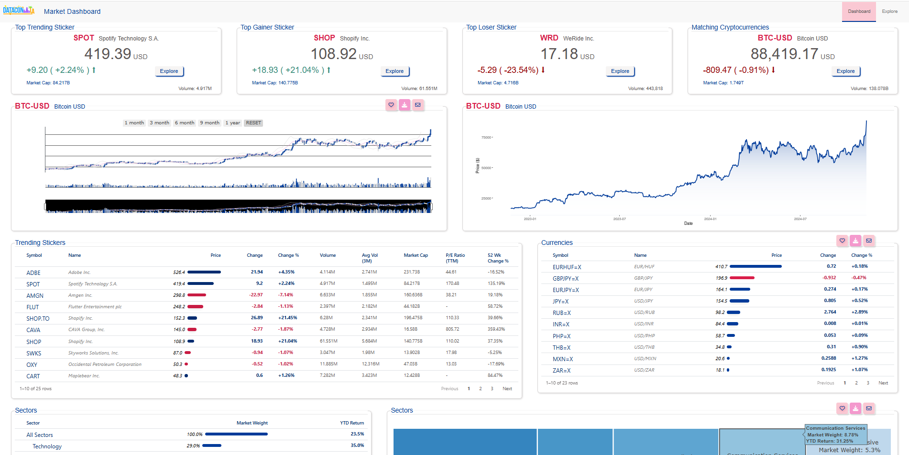
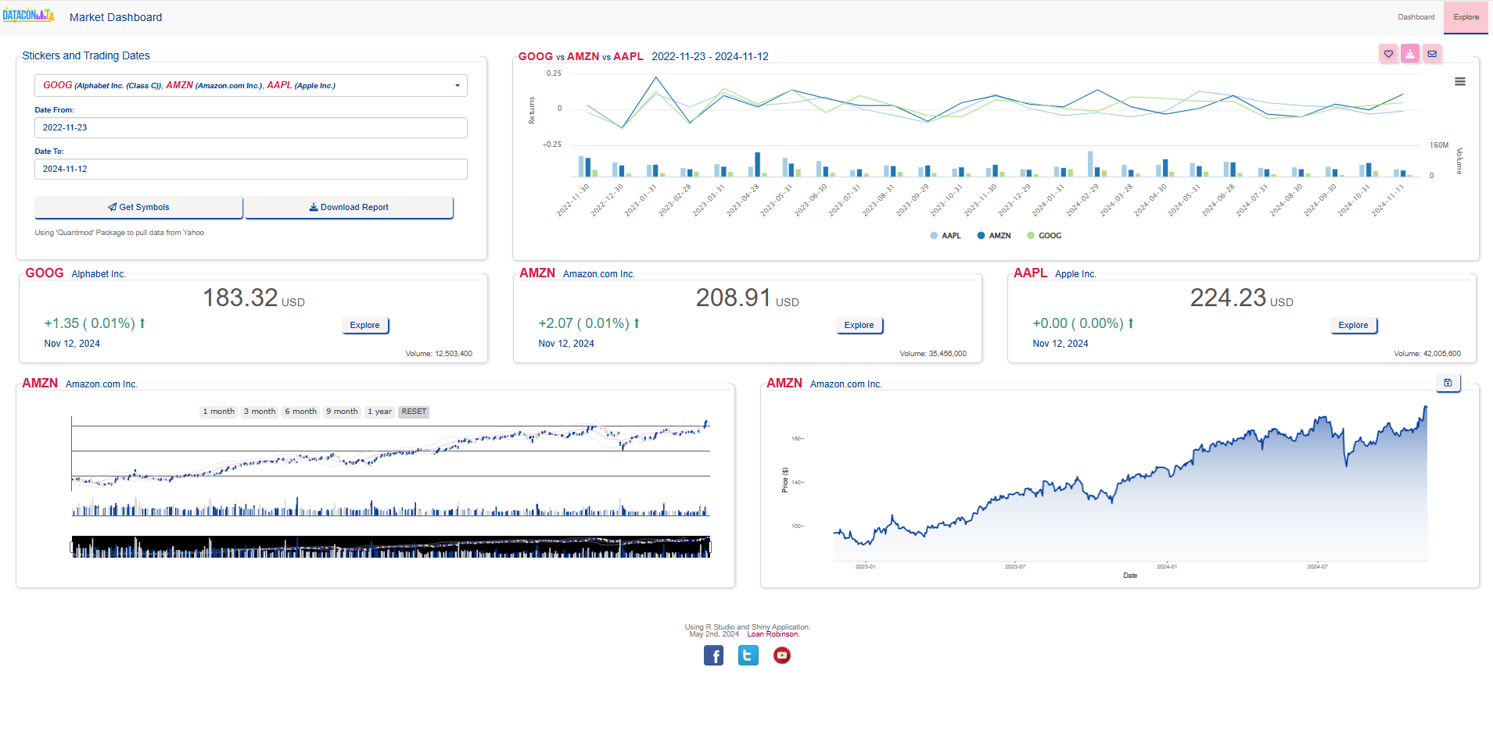
Front End UI
Look Prettier !
style.css
navbarPage…
Shiny layout
Important !!!
Colors, Texts
Heart of the app
Charts, Tables
Inputs
Stickers input
Date from – Date to
Action buttons

Slide 6

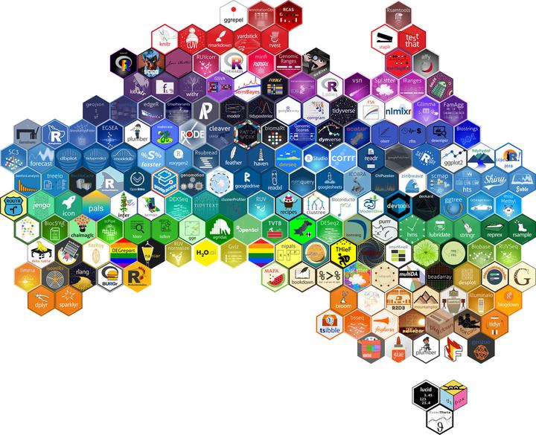
Back End Server
Data Source
Yahoo Website to pull data
https://finance.yahoo.com/trending-tickers
R Functions (they talk to each other)
Using `quantmod` package to get the stock prices
global.R
footer.R
global.R
footer.R
ui.R
losers.R
Sticker Names stored in data directory
ui.R
losers.R
server.R
trending.R
server.R
trending.R
crypto.R
all_line_plot.R
crypto.R
all_line_plot.R
gainers.R
dashboard_table.R
gainers.R
dashboard_table.R
inputs.R
explore_stickers.R
YOUR SHINY APP WILL BE
HERE
inputs.R
explore_stickers.R
explore_trending_stickers.R
R Libraries
download_md.R
explore_trending_stickers.R
www folder
logo
style.css

Slide 7
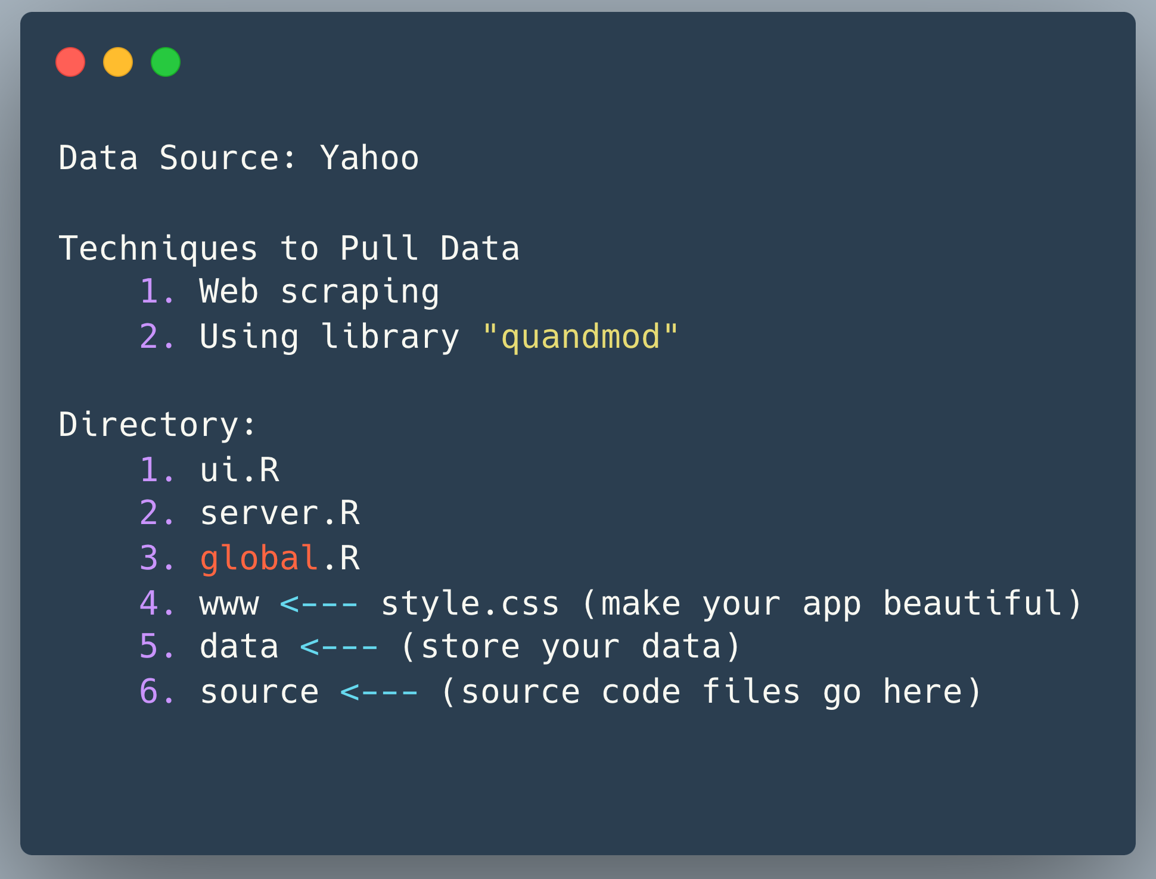
Market Dashboard Components

Slide 8
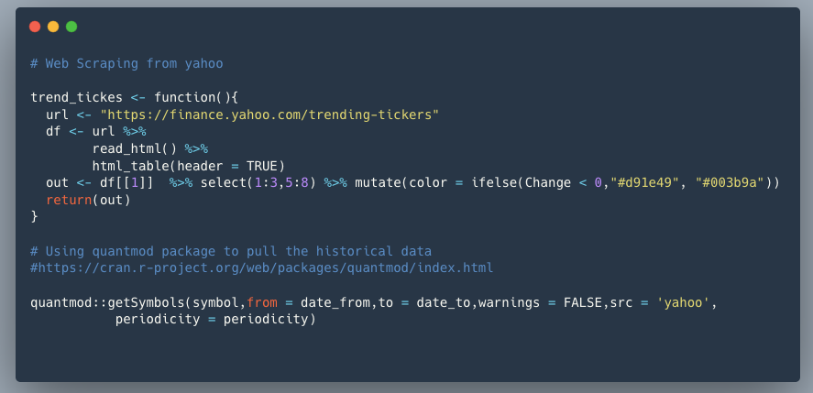
Web Scraping and Quantmod package

Slide 9
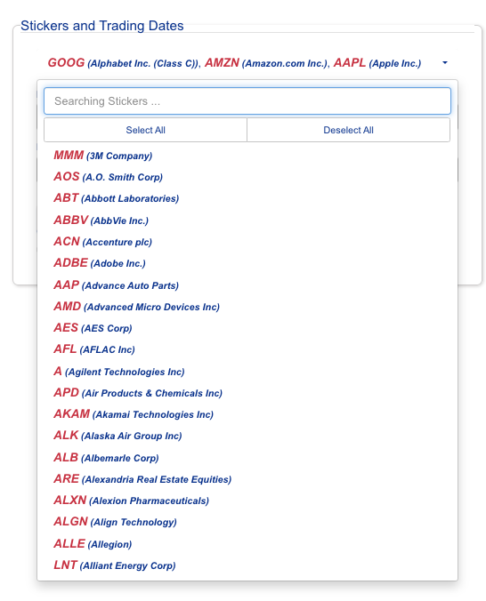
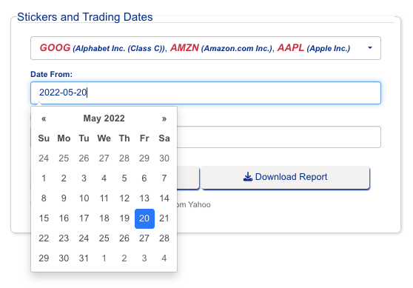
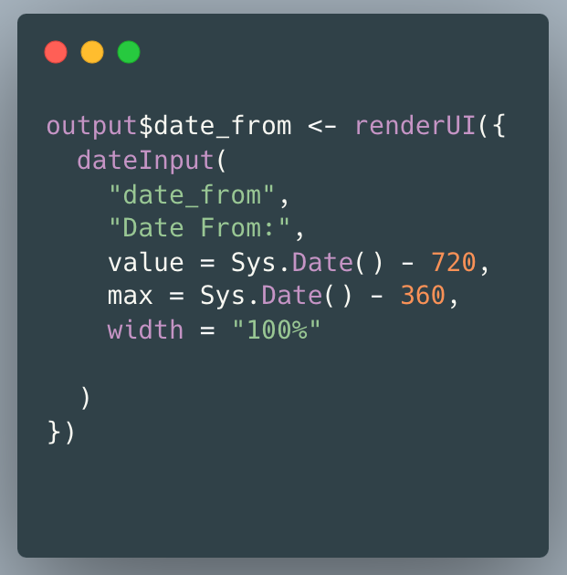
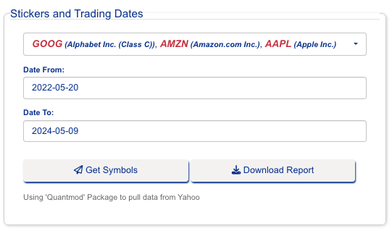
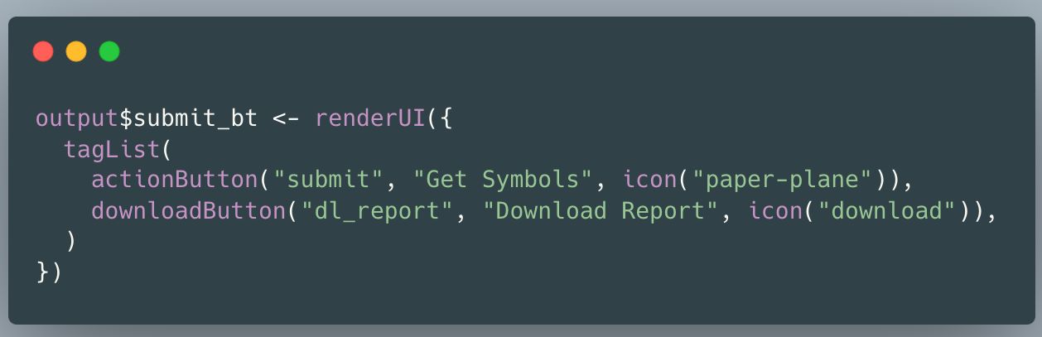
Inputs
1. Stickers
2. Date From – Date To
3. Get Symbols Button

Slide 10
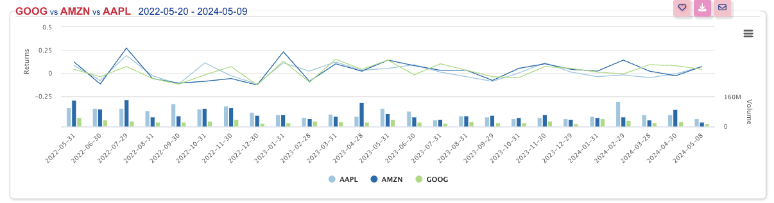
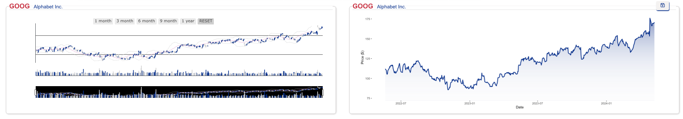
Outputs
Inputs
1. Stickers
2. Date From – Date To
3. Get Symbols Button
Inputs
Explore button

Slide 11
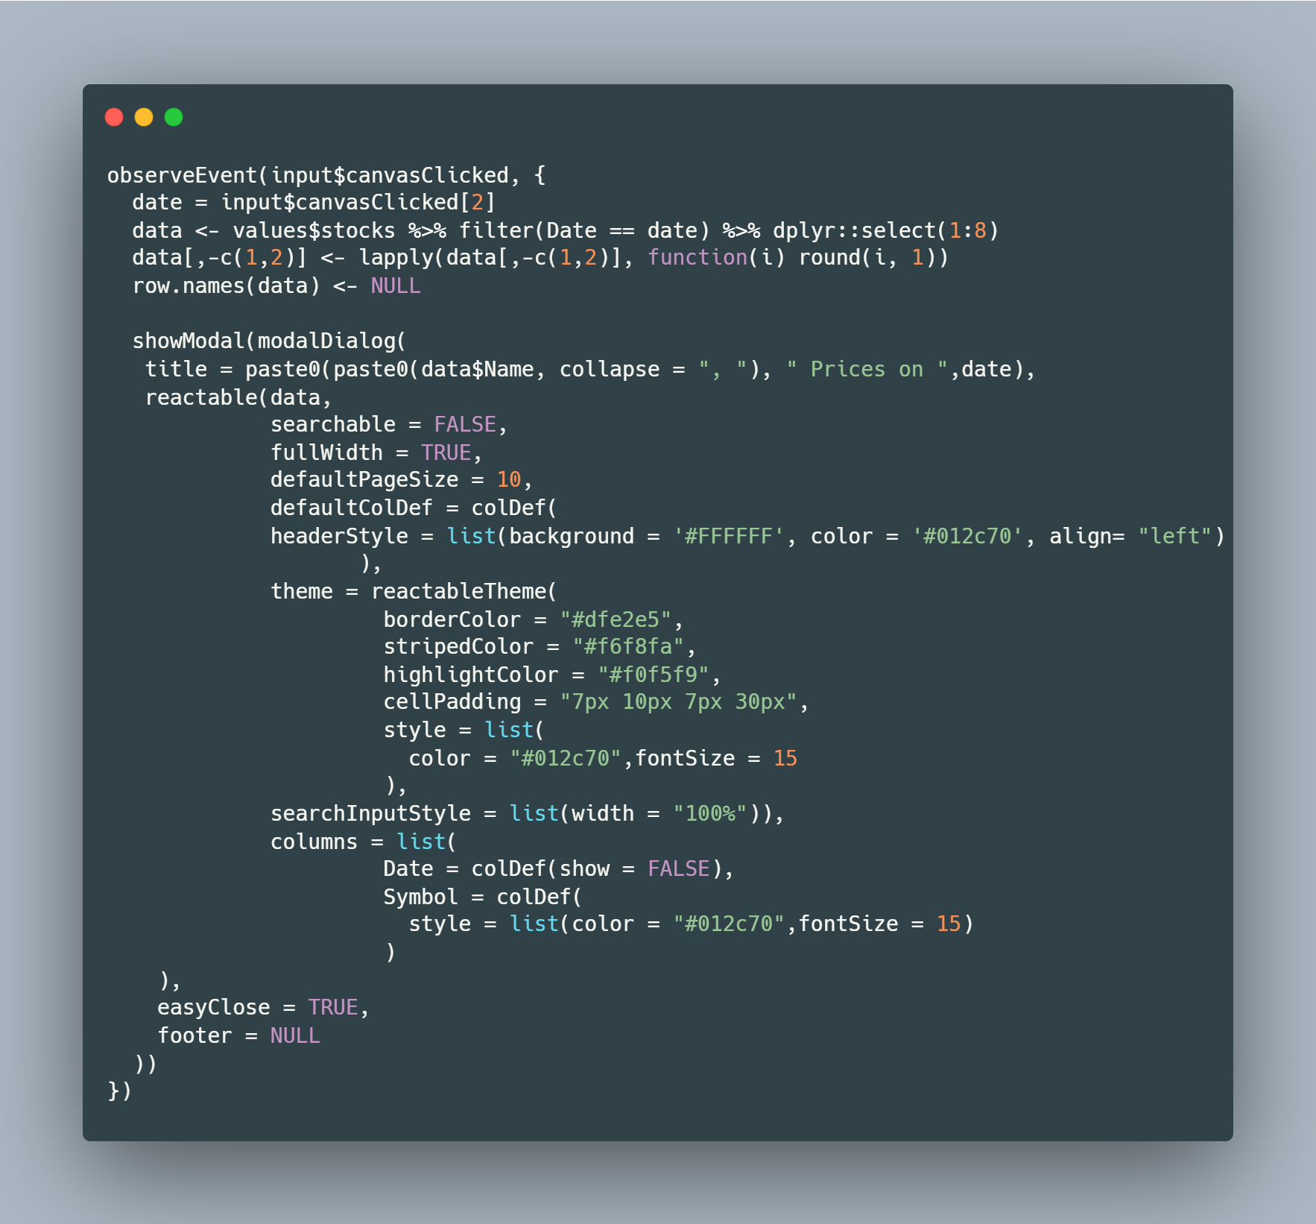
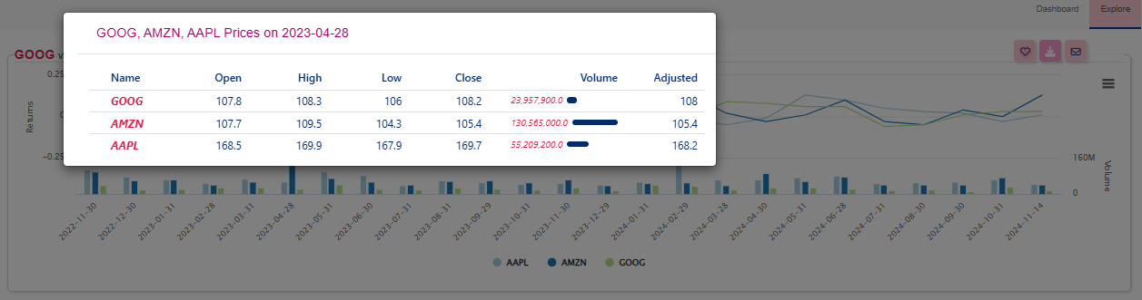
Event Clicks
Click on the bar chart
Create the Popup window

Slide 12
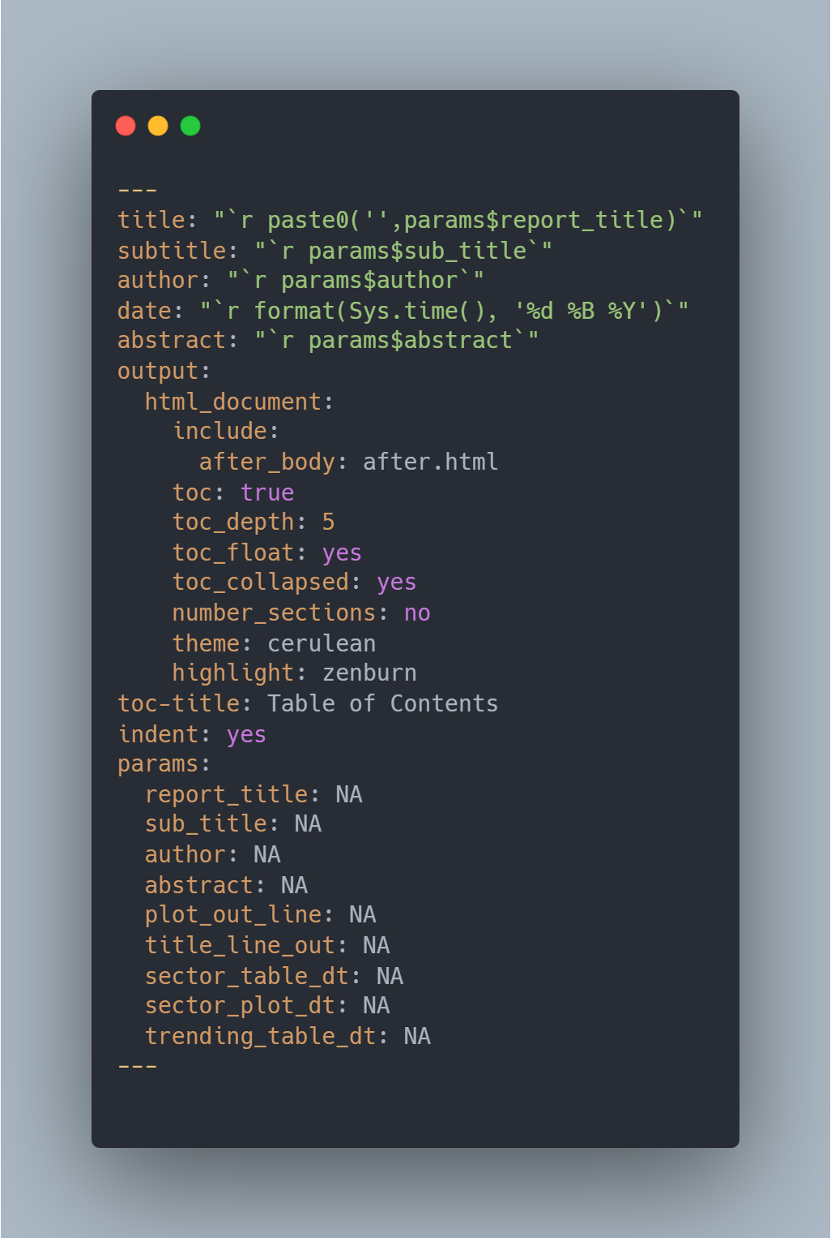
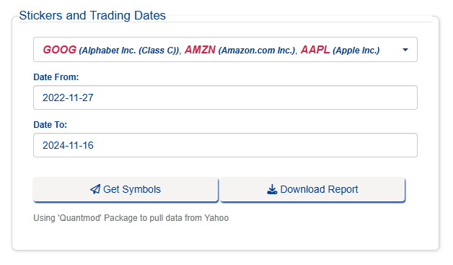
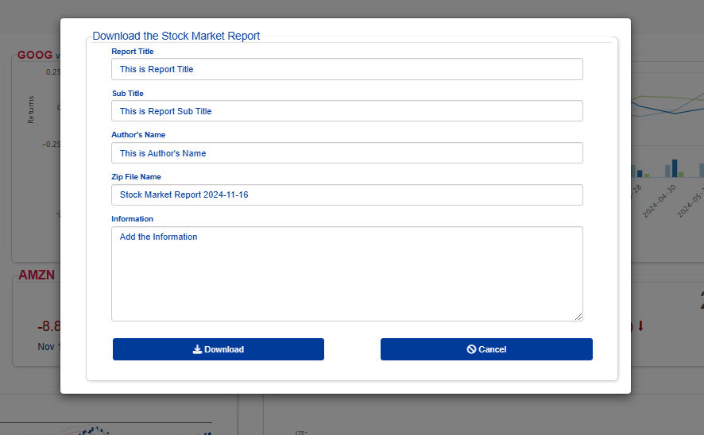
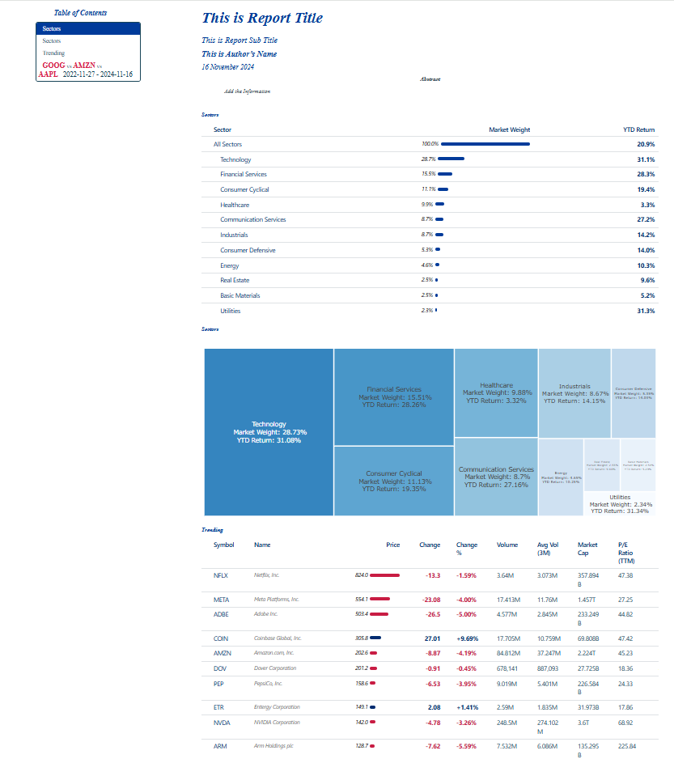
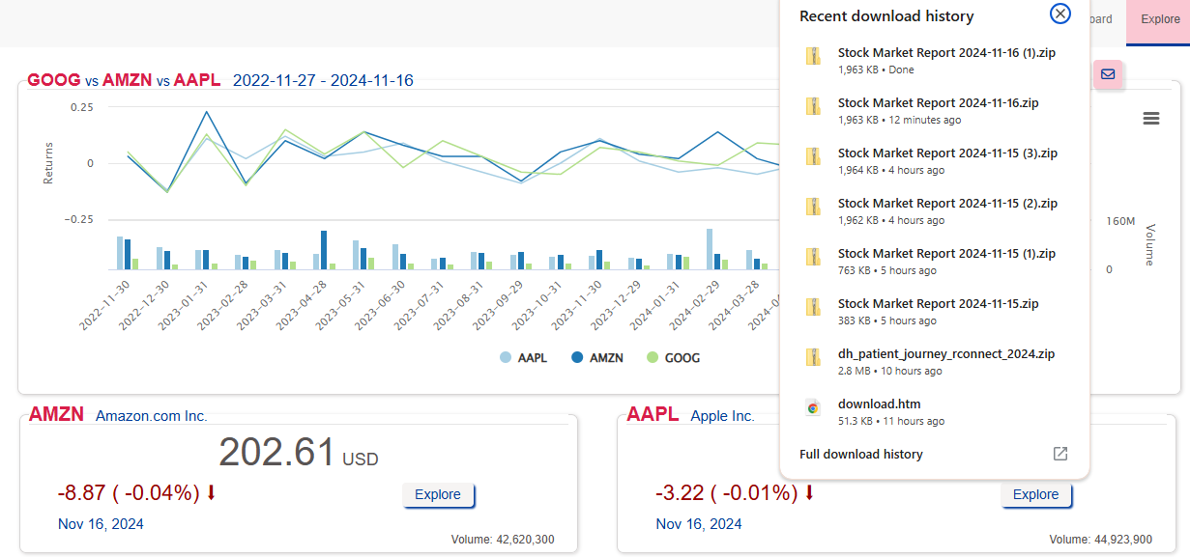
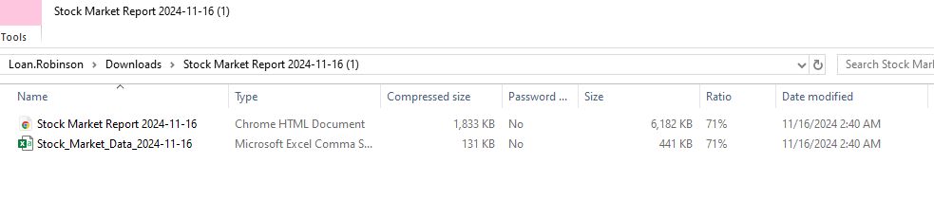
How to Generate the Reports
Download Information Popup
Rmd file function
Final html report
Note: You can include html, pdf, docx, ppt
Zip file stored in download directory

Slide 13
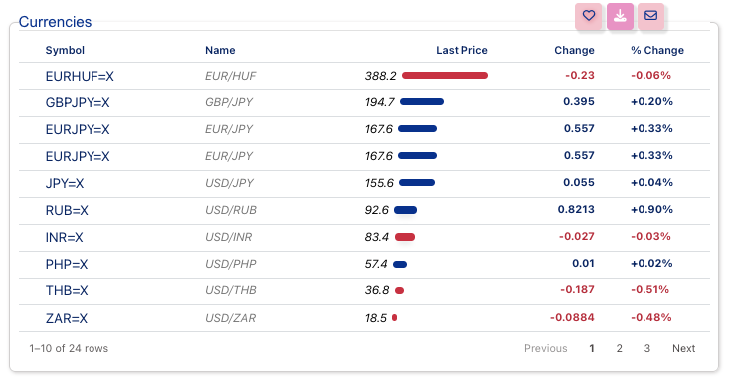
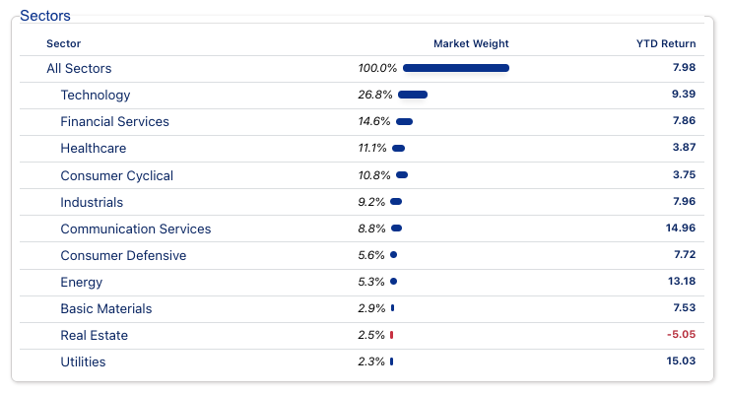
reactable and reactablefmtr Tables
https://kcuilla.github.io/reactablefmtr
https://glin.github.io/reactable

Slide 14
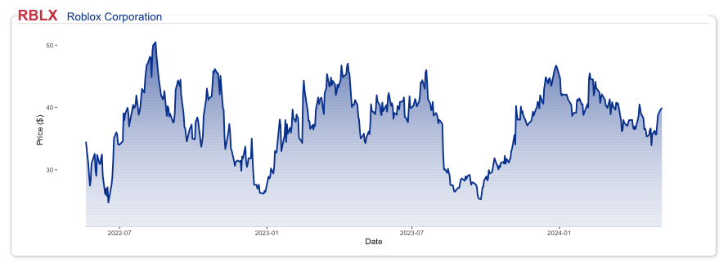
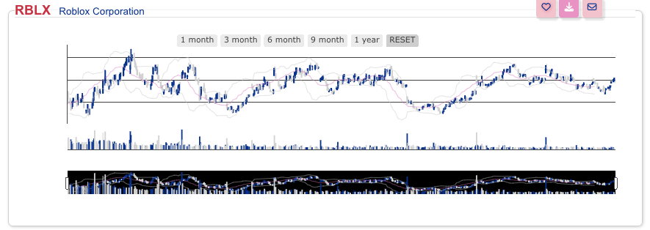
Figure Outputs
Ggplot2 package
plotly package

Slide 15
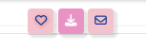
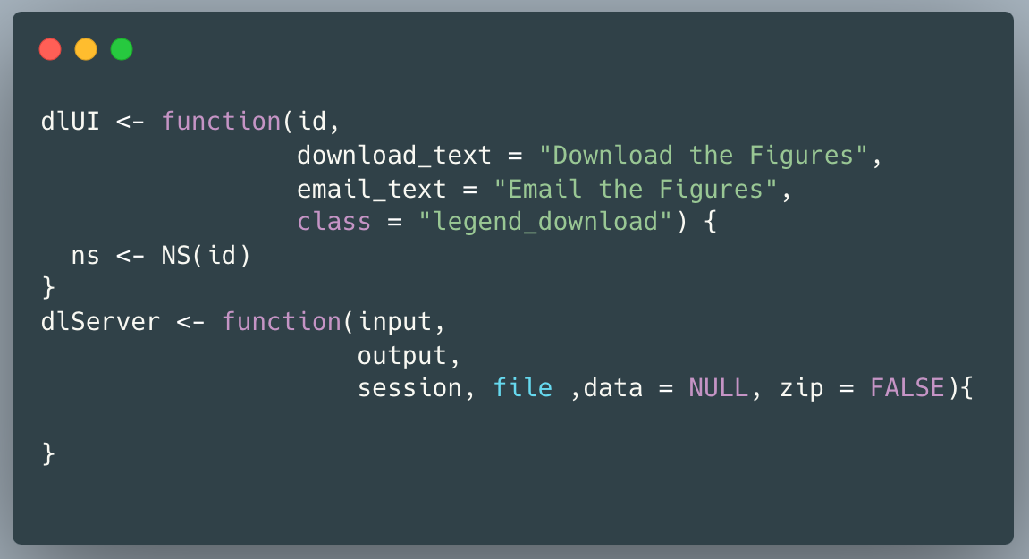
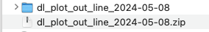
R Shiny Modules
Add to your favorite list
Download the zip file with figure and table
Send the figure and table to email

Slide 16
Questions ?
Application:
https://loanrobinsonscientist.shinyapps.io/stock_dashboard_app_final/
https://loanrobinsonscientist.shinyapps.io/stock_dashboard_dataconla2024/
Codes Available: https://github.com/loankimrobinson/stock_market_conference
Questions to: loankimrobinson@gmail.com
Thank you for attending

